Slide 1
Lecture 9 – Logistic Regression Part 1
Instructor: Hamed Hasheminia

Slide 2
Agenda
Intro to Logistic Regression
Odds and Log of Odds
Using Logistic Regression to make predictions
How to interpret results of a Logistic Regression model
How to interpret coefficients of a Logistic Regression Model
Strengths and weaknesses of Logistic Regression Models

Slide 3
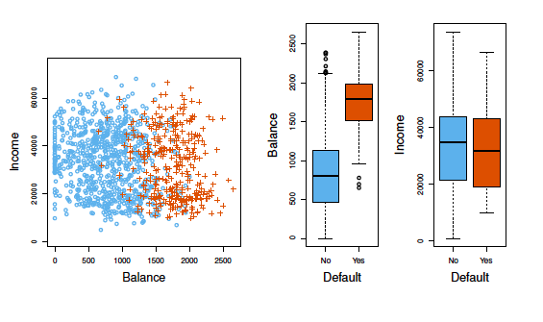
Credit Data

Slide 4

Can we use Linear Regression?
Suppose that the Default classification task that we code
Can we simply preform a linear regression of Y on X and classify as Yes if Y_hat > 0.5?

Slide 5
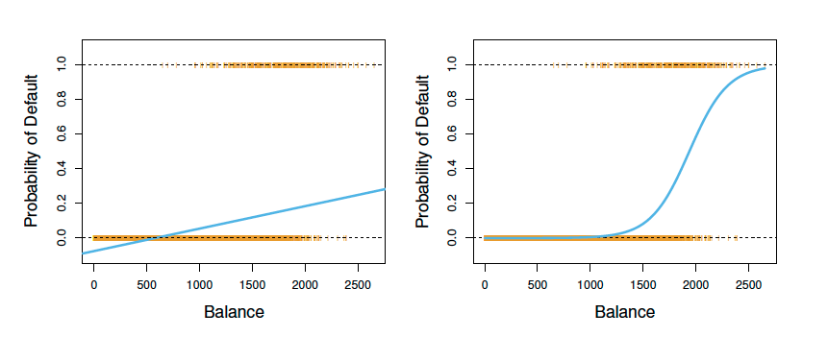
Credit data
The orange marks indicate the response Y, either 0 or 1. Linear regression does not estimate Pr(Y = 1|X) well. Logistic regression – the right hand side graph - seems well suited to the task.
Notes:
The yellow at top of left is a defaulter line, and the yellow at the bottom who did not default.

Slide 6
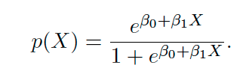
Logistic Regression
Let’s write p(x) = Pr(Y =1|X) for short and consider using balance to predict default. Logistic regression uses the form:
(e = 2.51828.. is a mathematical constant [Euler’s number.])
It is easy to see that no matter what values beta_0, beta_1 or X take, P(x) will have values between 0 and 1.
Notes:
This gives probability

Slide 7
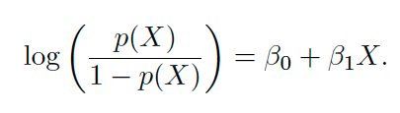
Logistic Regression
A bit of rearrangement gives
This monotone transformation is called the log odds or logit transformation of p(X).
Notes:
The left hand side inside the log is the odds, the log of odds is linear logit logit logit logit

Slide 8
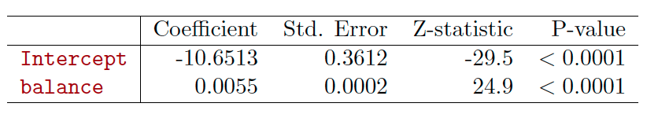
Maximum Likelihood Estimation
Most statistical packages can fit linear logistic regression models by maximum likelihood.
What is our estimated probability of default for someone with a balance of $1000?
How about with a balance of $2000?
Notes:
For every dollar increase in balance my odds of default increase by .5% so at $1 vs $2, the odds go up by 1.1%

Slide 9

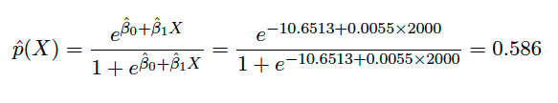
Making predictions
Balance = $1000
Balance = $2000
Notes:
Beta i is percentage change in odds

Slide 10
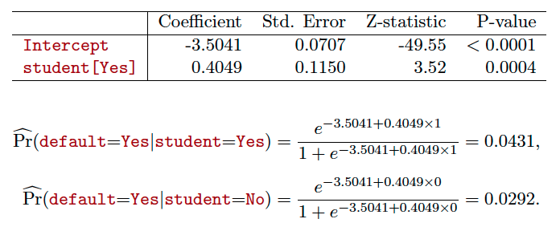
What if we have categorical inputs?
Let’s do it again, using student as the predictor.

Slide 11
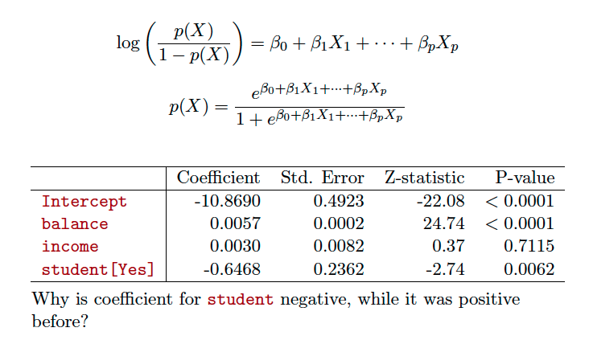
Logistic regression with several variables
Notes:
Given same balance, student less likely to default

Slide 12
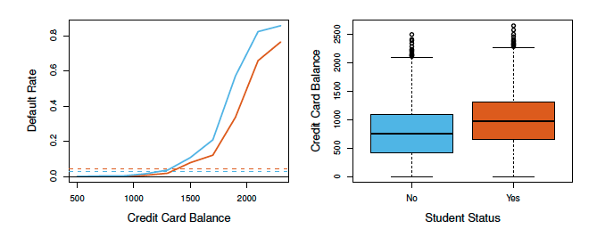
Confounding
Students tend to have higher balances than non-students, so their marginal default rate is higher than for non-students.
But for each level of balance, students default less than non-students

Slide 13
How do we interpret coefficients?
One can explain beta_i as an approximation for percentage change in odds for a unit change of X_i keeping all other variables constant.
Slightly more accurate way of measuring the precentage change of odds for a unit change of X_i would be to use
exp(beta_i) – 1
For small values of beta_i, these two measures are very close.

Slide 14
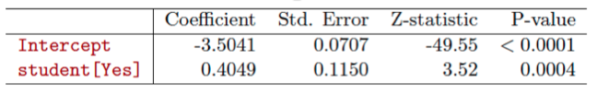
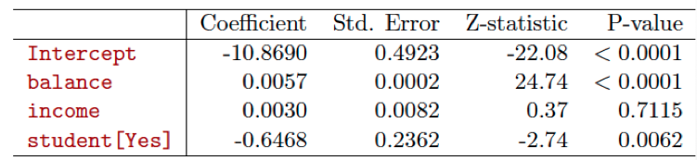
Let’s interpret coefficients of Logistic Regression

Slide 15
A few notes about Logistic regression lines
For categorical data, these models are among the most interpretable models.
If you have more than 2 categories, then you shall use another class of logistic regression models called multinomial regression line. (you can use such models for prediction but model’s interpretability decreases.)
If we you have well-separated classes, then logistic regression model give you unstable results
You do not need to standardize your inputs to train a logistic regression model
Almost every concept discussed for linear regression lines can be used in logistic regression lines – i.e. (p-values, interaction effects, etc)

Slide 16
Summary
We discussed the use of Logistic Regression
The definition of odds were introduced
We used Logistic Regression to make predictions
We learned hot to interpret the results of a Logistic Regression model
Lastly we discussed strengths and weaknesses of Logistic Regression Models

